Slide 1
OrdinalFed
IEEE WIECON-ECE 2026 · Paper ID 518
Federated Learning with Ordinal-Aware Aggregation for Diabetic Retinopathy Grading
Md Tamim Hossain, Najifa Raksanda, M. M. Tamim Sharif, Aria Nawshin Ashka
Department of Computer Science and Engineering · Military Institute of Science and Technology (MIST), Dhaka, Bangladesh
Notes:
Good morning, everyone. I am Md Tamim Hossain from the Department of Computer Science and Engineering, MIST. Today I will present our paper, “OrdinalFed: Federated Learning with Ordinal-Aware Aggregation for Diabetic Retinopathy Grading.” This is joint work with Najifa Raksanda, M. M. Tamim Sharif and Aria Nawshin Ashka.

Slide 2
Diabetic retinopathy
THE PROBLEM
Five grades of DR
13.1M
0
No DR
1
Mild
people with diabetes in Bangladesh
2
Moderate
A leading cause of preventable blindness, and few eye specialists outside the big cities
3
Severe
4
Proliferative
Grades 2–4 need referral. Finding them early prevents vision loss.
OrdinalFed · IEEE WIECON-ECE 2026
2
Notes:
Diabetic retinopathy, or DR, is damage to the small blood vessels of the retina caused by diabetes. It is one of the main causes of preventable blindness. In Bangladesh alone, more than 13 million people have diabetes, and outside the big cities there are very few eye specialists. Doctors grade DR on five levels, from Grade 0, no disease, to Grade 4, the most severe. Finding Grade 2 and above early can prevent vision loss. So an automatic grading model would be very useful.

Slide 3

Why federated learning?
BACKGROUND
Hospitals cannot easily share patient images because of privacy rules. Federated learning trains one shared model without moving the images.
1
2
3
Train locally
Send weights
Combine
Each hospital trains the model on its own images
Only model weights go to the server, never the images
The server merges them into one global model and sends it back
This repeats for several rounds. FedAvg, the standard method, weights each hospital by its number of images.
OrdinalFed · IEEE WIECON-ECE 2026
3
Notes:
Deep learning models grade DR well when all images are collected in one place. But privacy rules make it hard for hospitals to share patient images. Federated learning solves this. Each hospital trains the model on its own images. Then it sends only the model weights to a server, never the images. The server combines them into one global model and sends it back. This repeats for several rounds. The standard way to combine the models is called FedAvg. It weights each hospital by how many images it has.

Slide 4
Two problems
THE CHALLENGE
PROBLEM 1
PROBLEM 2
Hospitals see different patients
Grades have an order
Screening clinics see mostly healthy eyes. Referral hospitals see many severe cases.
The usual loss, cross-entropy, treats every wrong grade the same.
0.647 → 0.378
Grade 4 called Grade 3: small mistake
Grade 4 called Grade 0: big mistake
FedAvg test QWK, best round → worst round, under extreme skew
QWK (quadratic weighted kappa): the standard score for ordered grades. 1 = perfect; far-off mistakes cost more.
OrdinalFed · IEEE WIECON-ECE 2026
4
Notes:
There are two problems. First, hospitals see very different patients. A screening clinic sees mostly healthy eyes, while a referral hospital sees many severe cases. When the data are this uneven, FedAvg can collapse. In our experiments under extreme skew, its test QWK dropped from 0.647 in its best round to 0.378 in its worst. QWK is the standard score for ordered grades: 1 means perfect, and far-off mistakes cost more. Second, the usual loss, cross-entropy, ignores the order of the grades. For cross-entropy, calling a Grade 4 image Grade 0 is no worse than calling it Grade 3. But clinically, the first mistake is much worse.

Slide 5


OrdinalFed has two parts
OUR METHOD
AT EACH HOSPITAL
AT THE SERVER
1. OrdinalLoss
2. QWK-weighted aggregation
Cross-entropy plus a penalty for how far the predicted grade is from the true grade.
The server keeps 50 balanced images (10 per grade) and scores each hospital’s model with QWK.
Loss = (1 − λ) · CE + λ · (ŷ − y)²
Better models get more weight.
No change at the hospitals. No extra communication.
Calling a Grade 4 image “Grade 0” costs 16× more than calling it “Grade 3”.
OrdinalFed · IEEE WIECON-ECE 2026
5
Notes:
Our method, OrdinalFed, has two parts. The first part works at each hospital. We add a distance penalty to cross-entropy. The model predicts an expected grade, and we penalise the squared distance from the true grade. So predicting Grade 0 for a Grade 4 image costs 16 times more than predicting Grade 3. The second part works at the server. The server keeps a small, balanced set of 50 images, 10 from each grade. After each round, it scores every hospital’s model on these images using QWK, and gives better models more weight. The hospitals do not need to change anything, and no extra data is sent.

Slide 6
How the server sets the weights
OUR METHOD
1
2
3
Score
Convert
Mix
QWK of each model on the 50 server images
A softmax turns the scores into quality weights
weight = β · image share + (1 − β) · quality
Round 1: β = 0.5 (counts and quality equal)
Round 10: β = 0 (quality only)
β falls smoothly over the rounds. Every hospital keeps a minimum weight, so no one is ever left out.
OrdinalFed · IEEE WIECON-ECE 2026
6
Notes:
Here is how the server sets the weights. First, it scores each model on its 50 images. Second, a softmax turns these scores into quality weights. Third, it mixes two things: each hospital’s share of the images, and its quality weight. A factor called beta controls the mix. In round 1, beta is 0.5, so image counts and quality count equally. Beta then falls smoothly to zero, so in the last round only quality is used. We never drop a hospital, because a score from only 50 images is noisy.

Slide 7
Experimental setup
EXPERIMENTS
Dataset | DDR: 12,522 gradable fundus images (6,260 train · 2,503 validation · 3,759 test)
Clients | 5 hospitals; data split 3 ways (next slide)
Model | EfficientNet-B3, 224 × 224 pixels
Training | 10 rounds × 5 local epochs, 3 random seeds
Compared with | FedAvg · FedProx · AccWt · OrdinalFed + Prox
External test | APTOS 2019 (3,662 images), no retraining
OrdinalFed · IEEE WIECON-ECE 2026
7
Notes:
We tested on the DDR dataset, which has 12,522 gradable fundus images, split into training, validation and test sets. We used five hospital clients and an EfficientNet-B3 model at 224 by 224 pixels. Each method ran for 10 rounds with 5 local epochs, and every experiment was repeated with three random seeds. We compared OrdinalFed with FedAvg, FedProx, an accuracy-weighted baseline called AccWt, and OrdinalFed combined with FedProx. We also tested every trained model, without retraining, on a second dataset, APTOS 2019.

Slide 8
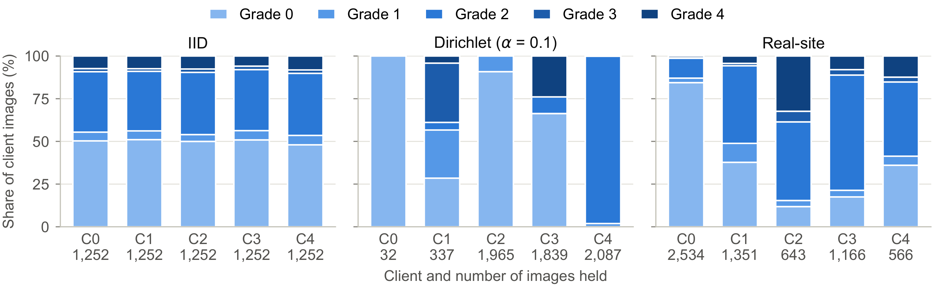
Three ways to split the data
EXPERIMENTS
Hardest case (middle): each client sees mostly one grade. Client 0 has only 32 images, all Grade 0; Client 4 has 2,087 images, 98% Grade 2.
OrdinalFed · IEEE WIECON-ECE 2026
8
Notes:
We split the data across the five clients in three ways. Each bar is one client, and the colours show its mix of grades. In the IID split, on the left, every client gets a random, similar mix. The middle panel is the hard case, a Dirichlet split with alpha 0.1. Here each client sees mostly one grade. Client 0 has only 32 images, all Grade 0, and Client 4 has 2,087 images, almost all Grade 2. The right panel models five real types of clinic, from screening clinics to specialist hospitals.

Slide 9
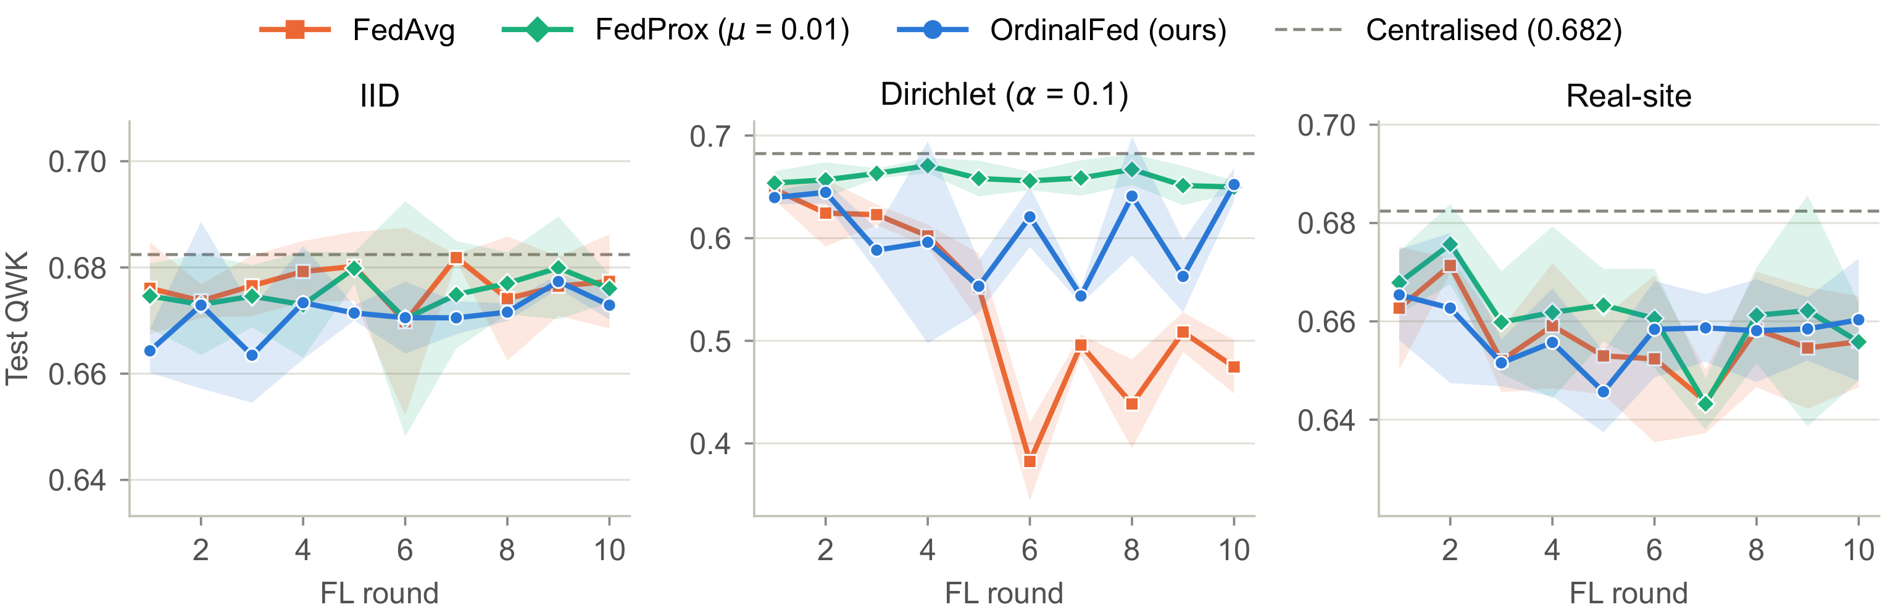
Test QWK after every round
RESULTS
Extreme skew (middle): FedAvg collapses from round 5. OrdinalFed avoids the collapse but goes up and down. FedProx stays flat.
OrdinalFed · IEEE WIECON-ECE 2026
9
Notes:
This figure shows the test QWK after each round. Orange is FedAvg, green is FedProx, blue is OrdinalFed, and the dashed line is the centralised model trained on all the data. On the IID and real-site splits, on the left and right, all methods stay close to the centralised model. The middle panel is the extreme skew. FedAvg collapses from round 5 onwards. OrdinalFed avoids the collapse, but it goes up and down. FedProx stays flat.

Slide 10
Worst round under extreme skew
RESULTS
Test QWK in the worst of the 10 rounds, mean of 3 seeds. Higher is better.
FedAvg
0.378
OrdinalFed (ours)
0.514
OrdinalFed + Prox
0.627
FedProx
0.641
OrdinalFed lifts the worst round from 0.378 to 0.514 (mean over rounds 0.535 → 0.604), with no change at the hospitals. FedProx is still the most stable.
OrdinalFed · IEEE WIECON-ECE 2026
10
Notes:
Here are the numbers for the worst round under extreme skew, averaged over three seeds. FedAvg drops to 0.378. OrdinalFed raises the worst round to 0.514, and the mean over all rounds from 0.535 to 0.604. But FedProx, which changes local training, is the most stable method, at 0.641. Adding FedProx’s term to OrdinalFed brings it close, at 0.627, but it does not beat FedProx.

Slide 11

Why does it work?
ABLATION
Configuration (extreme skew) | Worst-round QWK
Cross-entropy + image-count weights (FedAvg) | 0.378
OrdinalLoss + image-count weights | 0.380
Cross-entropy + QWK weights | 0.586
Cross-entropy + equal weights | 0.630 (best)
KEY INSIGHT
Small hospitals get a bigger voice
Weight of the two smallest clients, who hold 5.9% of the images:
5.9%
40.8%
FedAvg
OrdinalFed, round 10
The loss alone does not help. With only 50 server images, the QWK scores are too noisy to rank hospitals.
OrdinalFed · IEEE WIECON-ECE 2026
11
Notes:
Why does OrdinalFed help? We removed one part at a time. The OrdinalLoss alone does not stop the collapse: 0.380, the same as FedAvg. QWK weighting raises the worst round to 0.586. But simply giving every hospital the same weight does even better, at 0.630. The logged weights explain this. The two smallest clients hold 5.9% of the images, so FedAvg gives them 5.9% of the weight. OrdinalFed raises their weight to 40.8% by round 10. So the real gain comes from giving small hospitals a bigger voice. With only 50 server images, the QWK scores themselves are too noisy to rank the hospitals.

Slide 12
More results
RESULTS
≤ 0.01
0.36
Gap on IID and real-site splits
Best Grade 3 recall (OrdinalFed)
All methods perform about the same when the skew is mild.
Others: 0.27–0.31 under extreme skew. Grade 3 is the rarest severe grade.
0.60–0.66
1.2 s
QWK on external APTOS 2019
Extra server time per round
Close to the centralised model (0.641), with no retraining.
About 0.6% of a round. No extra communication.
OrdinalFed · IEEE WIECON-ECE 2026
12
Notes:
A few more results. On the IID and realistic multi-site splits, all methods were within 0.01 QWK of each other, so they perform about the same when the skew is mild. OrdinalFed had the best recall on Grade 3, the rarest severe grade: 0.36, against 0.27 to 0.31 for the others. On the external APTOS dataset, all models scored between about 0.60 and 0.66, close to the centralised model’s 0.641, so they transfer well. And the server cost is small: 1.2 seconds per round, with no extra communication.

Slide 13
Takeaways
CONCLUSION
1
Server-side weighting stops most of FedAvg’s collapse
Worst round 0.378 → 0.514, with no change at the hospitals
2
The gain comes from giving small hospitals more weight
Equal weights work even better (0.630)
3
FedProx is still the most stable method
Worst round 0.641
Next: larger server sets, higher resolution, more datasets and privacy guarantees.
OrdinalFed · IEEE WIECON-ECE 2026
13
Notes:
To conclude, there are three takeaways. First, OrdinalFed’s server-side weighting prevents most of FedAvg’s collapse under extreme skew, with no change at the hospitals and no extra communication. Second, the gain comes from giving small hospitals more weight; equal weights work even better. Third, FedProx is still the most stable method. Our study also has limits: the 50-image server set is small, no method detects Grade 1 well, and we trained on one dataset at low resolution. In future work, we will test larger server sets, higher resolution, more datasets, and formal privacy guarantees.

Slide 14
Thank you
Questions?
Md Tamim Hossain · tamim0072276@gmail.com
Department of Computer Science and Engineering, MIST, Dhaka, Bangladesh
Notes:
Thank you for listening. I am happy to take your questions.

